Slide 1

Fairness among TCP connections
CDR – Critical Design Review
Presented by:
Mohammad igbaria
Majd Mahameed
Project in Computer Networks LAB (LCCN)

Slide 2
Introduction
This presentation examines how different TCP congestion control protocols—New Reno, CUBIC, BBR, and DCTCP—share network resources fairly. We will evaluate their behaviour with Dumble topology under various scenarioes using fairness metrics like Jain’s Index, Max-Min, and Proportional Fairness, want to identify which protocols achieve better fairness in practice.

Slide 3
Congestion Control Protocols
TCP New Reno
TCP CUBIC
TCP BBR
DCTCP

Slide 4
TCP New Reno
TCP New Reno improves TCP Reno by handling multiple packet losses more efficiently. Instead of reducing the congestion window (cwnd) multiple times for each lost packet, New Reno uses partial ACKs to detect if all lost packets in a window have been recovered. It stays in fast recovery until all packets are acknowledged, avoiding repeated cwnd reductions and enabling faster recovery.

Slide 5
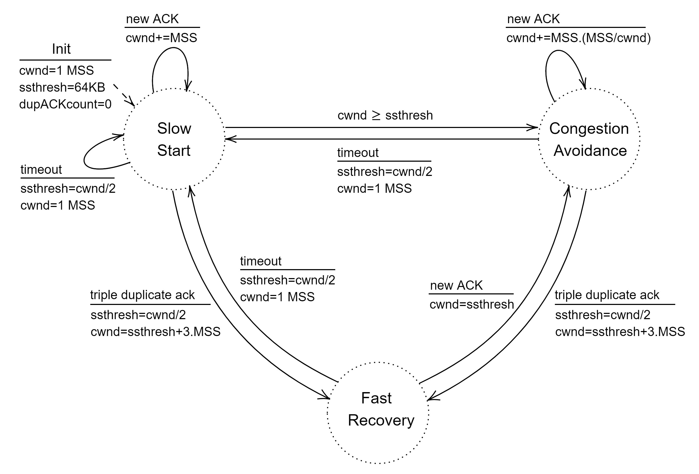
TCP New Reno algorithm

Slide 6
TCP CUBIC
TCP CUBIC is a modern congestion control algorithm designed for high-speed networks. Unlike older TCP versions that grow the congestion window linearly, CUBIC uses a cubic function to control growth. It increases the window slowly near the previous maximum to avoid congestion, then faster if no losses happen. This makes it more aggressive and efficient on fast, long-delay networks.

Slide 7
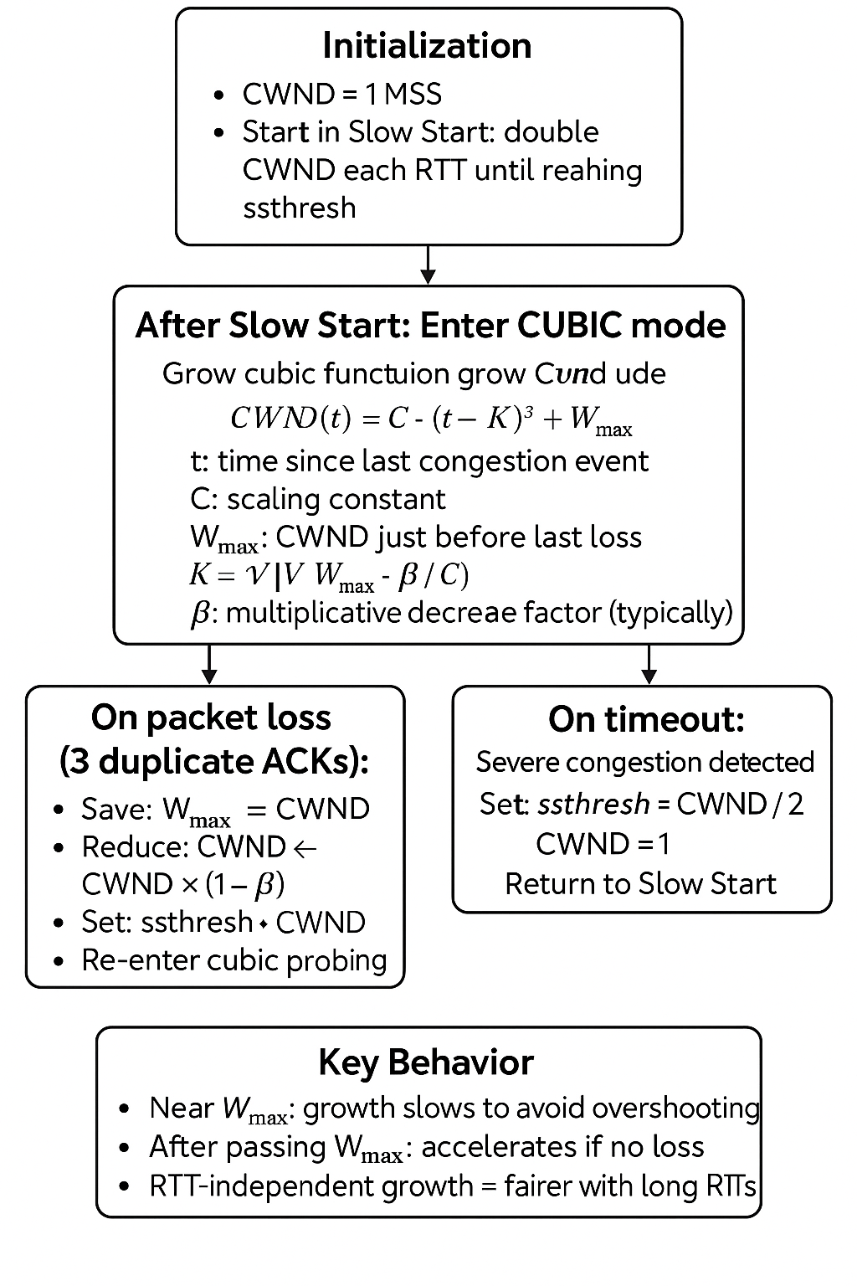
TCP CUBIC algorithm

Slide 8
TCP BBR
TCP BBR is a modern congestion control algorithm that aims to maximize throughput and minimize latency. Unlike traditional methods like Reno or CUBIC that rely on packet loss as a signal of congestion, BBR builds a model of the network by estimating the bottleneck bandwidth and round-trip time (RTT). This allows it to adjust the sending rate more accurately and keep queues short.

Slide 9
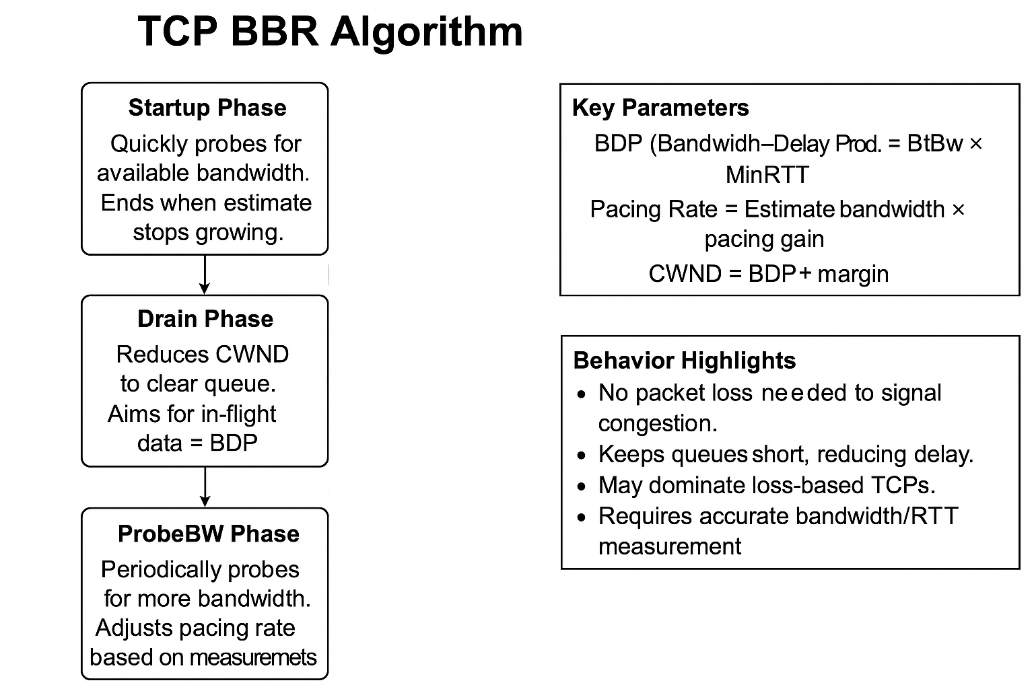
TCP BBR algorithms

Slide 10
DCTCP
DCTCP, or Data Center TCP, is a congestion control algorithm specifically designed for data center environments. Unlike traditional TCP, which reacts to packet loss, DCTCP uses Explicit Congestion Notification (ECN) to detect early signs of congestion before losses happen. This allows it to adjust the congestion window smoothly, reduce bufferbloat, and maintain low latency and high throughput—ideal for the high-speed, low-latency needs of data centers

Slide 11
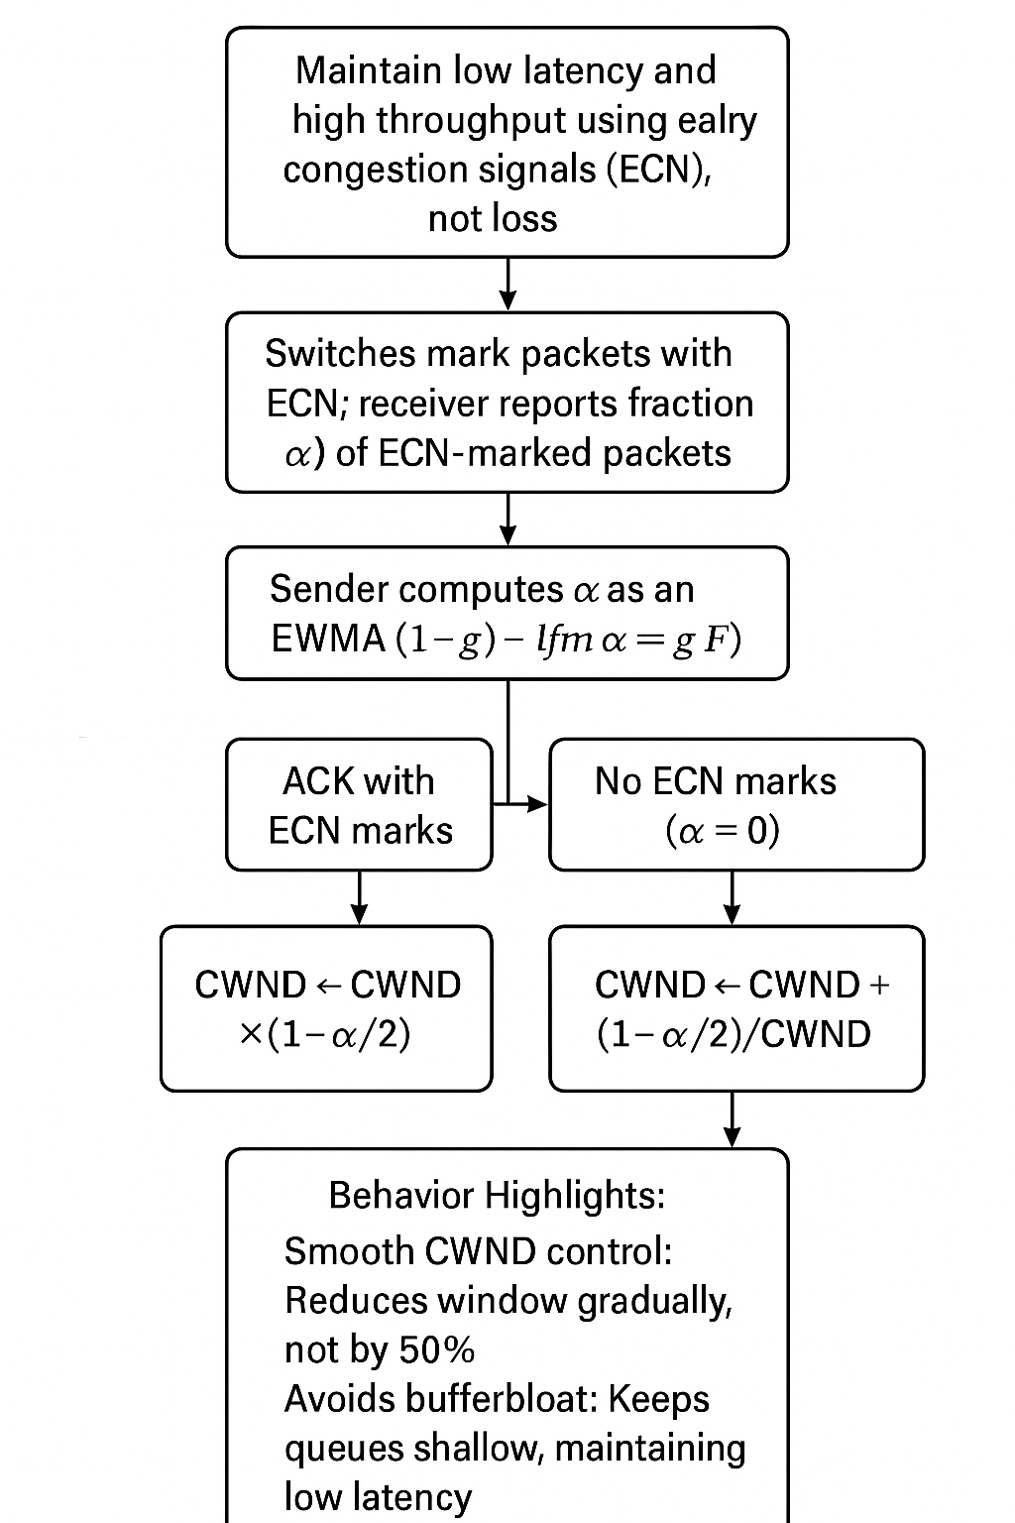
DCTCP algorithms

Slide 12
Fairness Concepts
• Jain’s Fairness Index (JFI)
• Max-Min Fairness
• Proportional Fairness
G-index

Slide 13
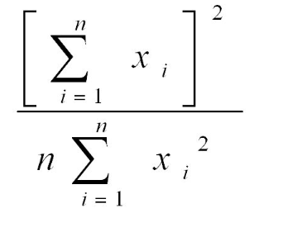
• Jain’s Fairness Index (JFI)
A numerical measure that tells how fairly resources (e.g. bandwidth) are shared among users or flows.
Formula:
where xi is the throughput of flow i, and n is the number of flows.
Interpretation:
Ranges from 0 to 1
1 = perfect fairness (all flows get equal share)
0= unfair distribution

Slide 14
Max-Min Fairness
A resource allocation strategy that tries to maximize the minimum throughput across all flows.
Principle: No flow can increase its rate without decreasing the rate of a flow with equal or lower allocation.
Goal: Protect the weakest/slowest flow from starvation.
Example: If 3 flows share a link, and one flow can only use 2 Mbps, Max-Min gives that flow 2 Mbps first, then fairly divides the rest.

Slide 15
Proportional Fairness
Balances efficiency and fairness by maximizing the sum of log(throughput).
Principle: A change in allocation is accepted only if the sum of proportional gains > losses.
Effect: Slightly favors higher-throughput flows, but still fair overall.
Example: Allocating 8 Mbps and 2 Mbps to two users may be preferred over 5/5 if the overall network utility (log-sum) is higher.

Slide 16
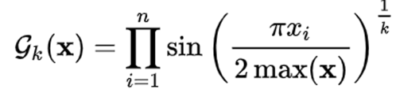
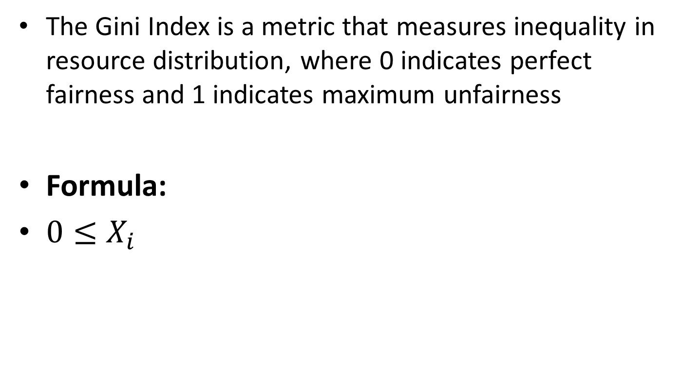
G-index
The Gini Index is a metric that measures inequality in resource distribution, where 0 indicates perfect fairness and 1 indicates maximum unfairness
Formula:
${0≤X}_{i}$

Slide 17
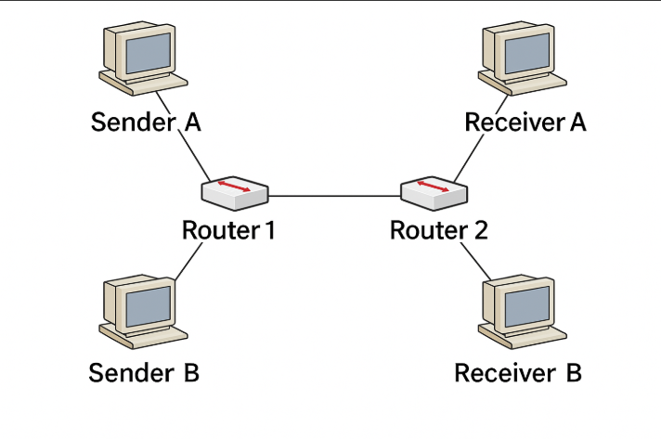
Our topology

Slide 18
Test 1 – equal flows
Set up : the same flows and RTT and same protocol and same size
Metrics : JFI , per- flow throughput
Expectation : G-index=0, JFI=1, all flows should achieve nearly equal throughput

Slide 19
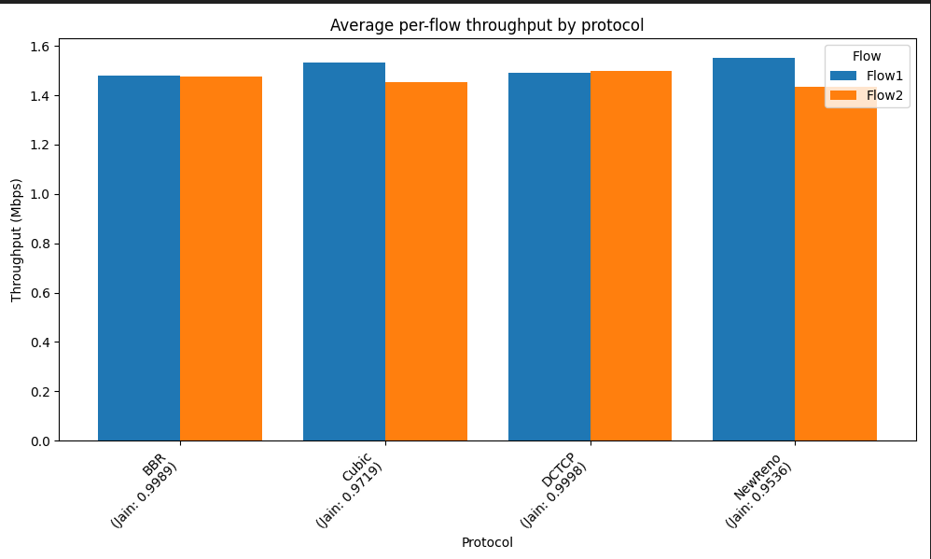
Set up : Number of flows=2 ,same RTT=10ms, bandwith= 4ms

Slide 20
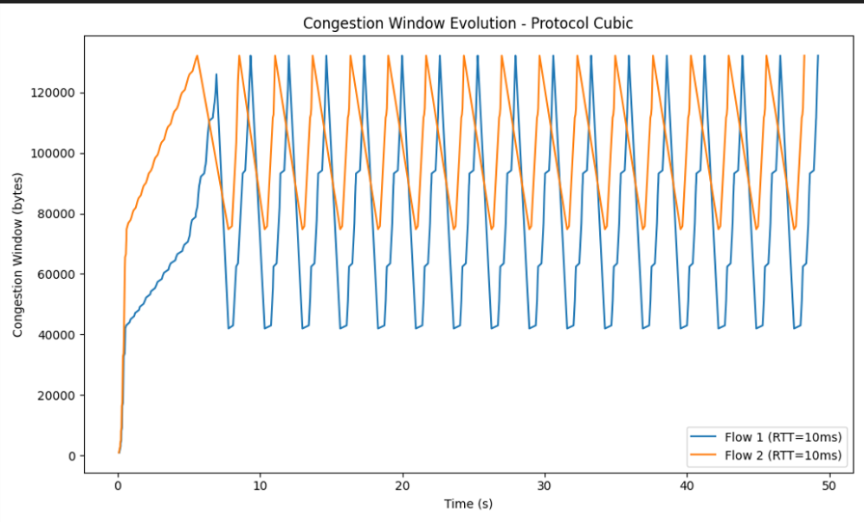
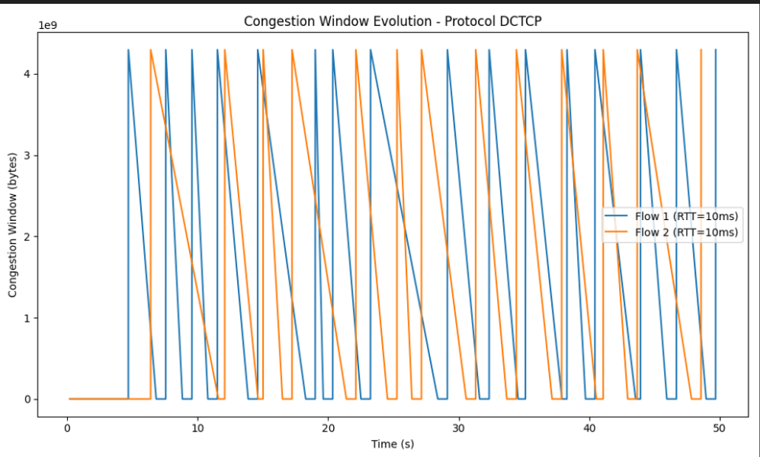
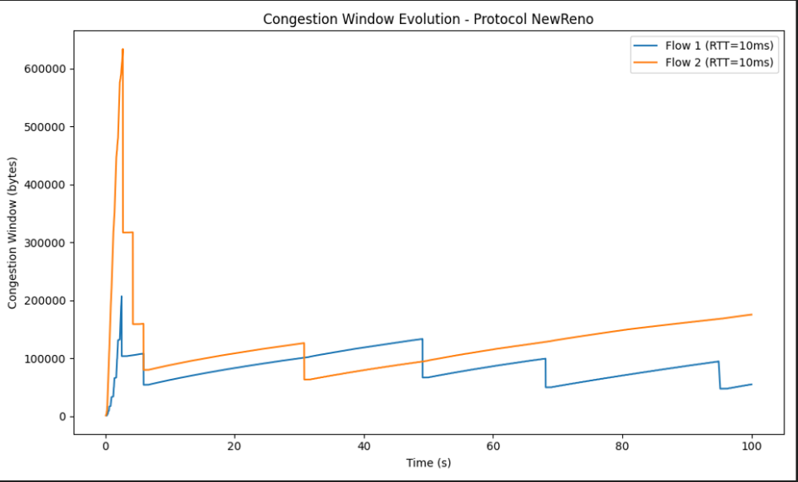
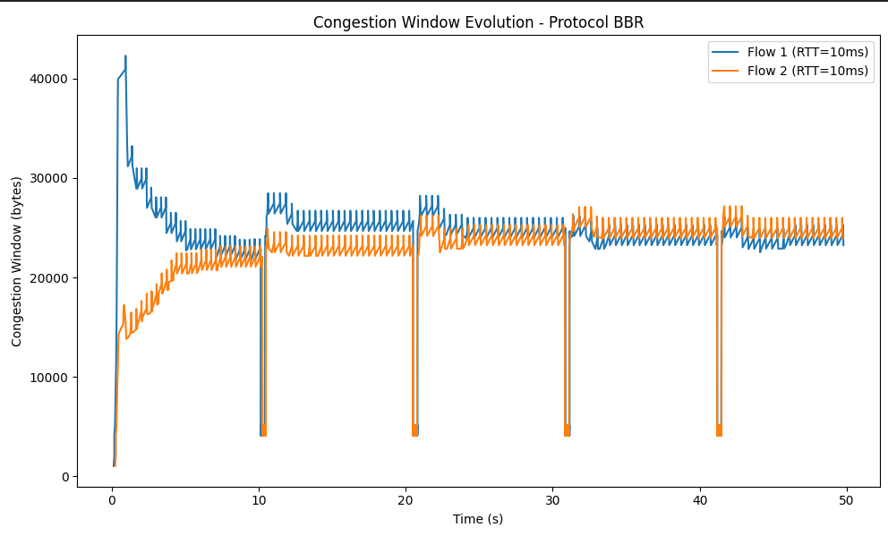

Slide 21
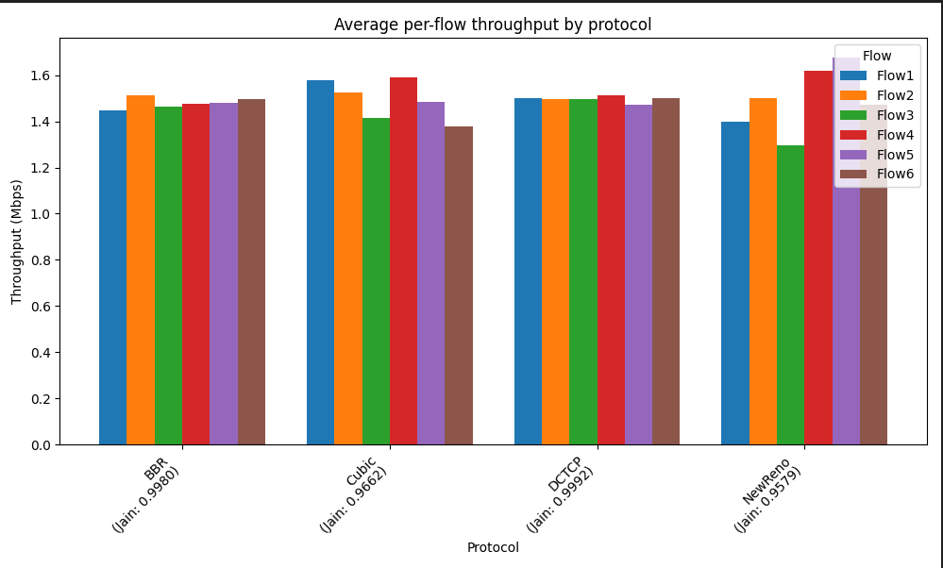
Set up : Number of flows=6,RTT=10ms, bandwith= 4ms

Slide 22
Test 2 - unequal RTTs
Why: To observe how different TCP protocols handle fairness when flows experience different round-trip times.
Set up: Two flows using the same protocol Flow 1 RTT = 1ms, Flow 2 RTT = 50ms
Metrics: Per-flow throughput, Jain’s Index
Expectations: -Loss-based protocols like Reno and CUBIC may Favor low RTT flows - BBR and DCTCP expected to handle RTT disparity better - JFI < 1 due to imbalance in flow rates

Slide 23
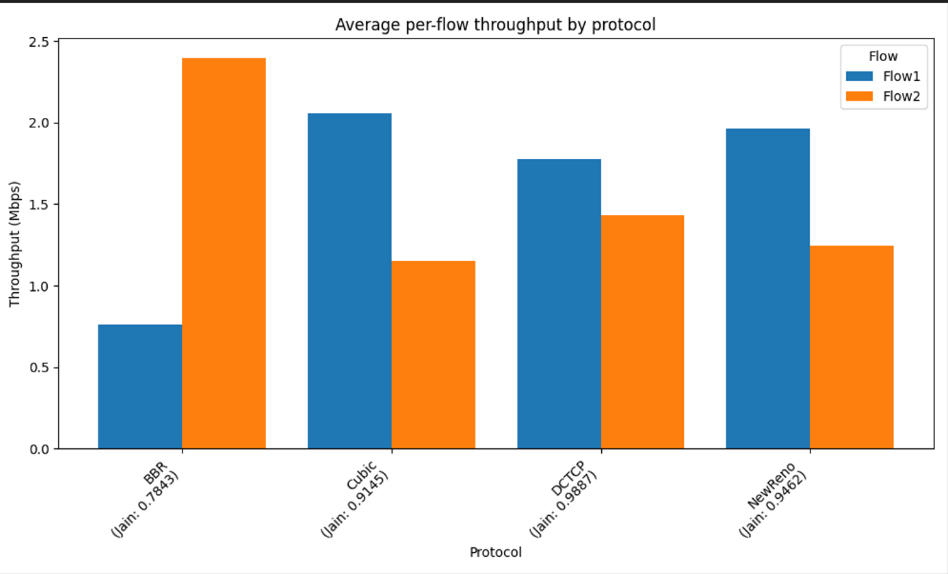
Set up : Number of flows=2 ,flow 1= 10ms, flow 2= 50ms, bandwith= 4ms

Slide 24
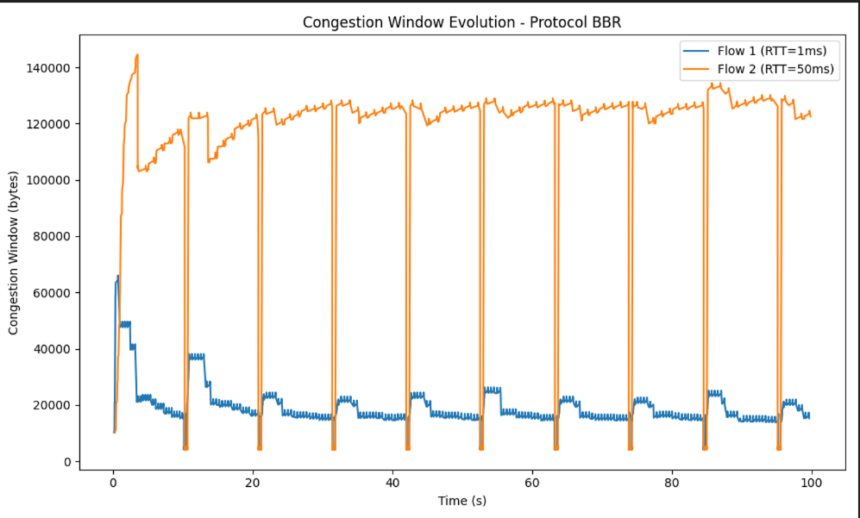
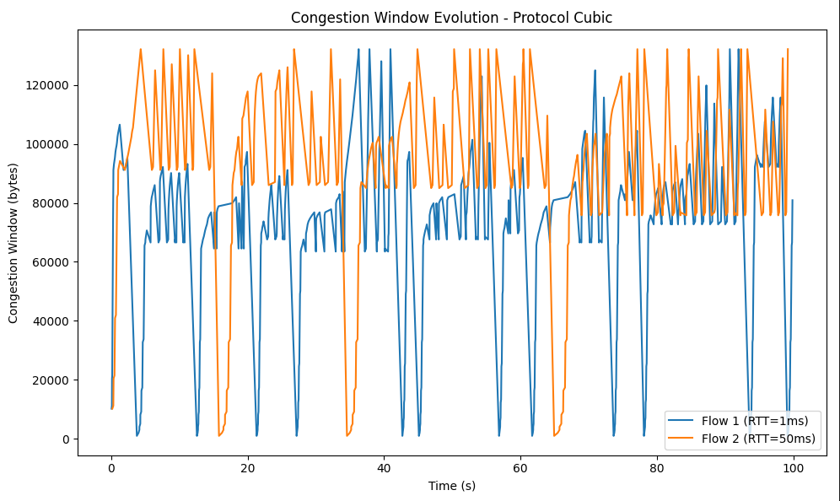
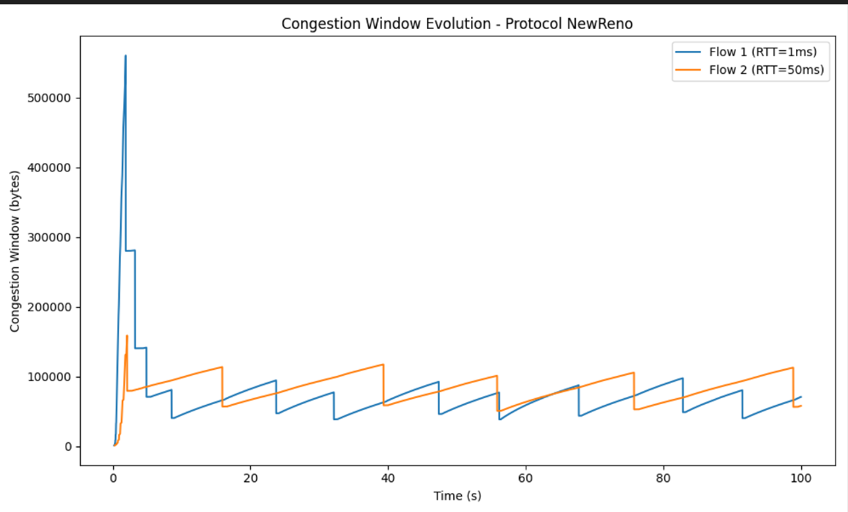
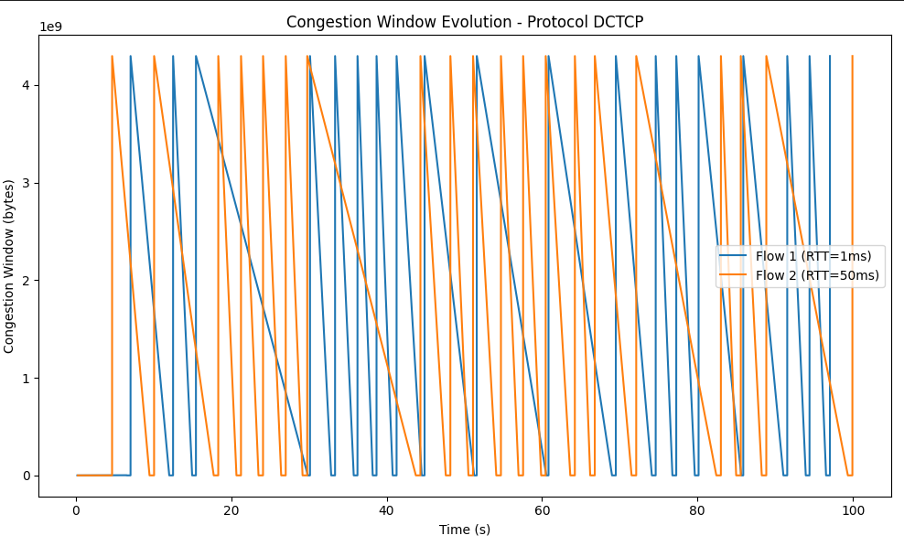

Slide 25
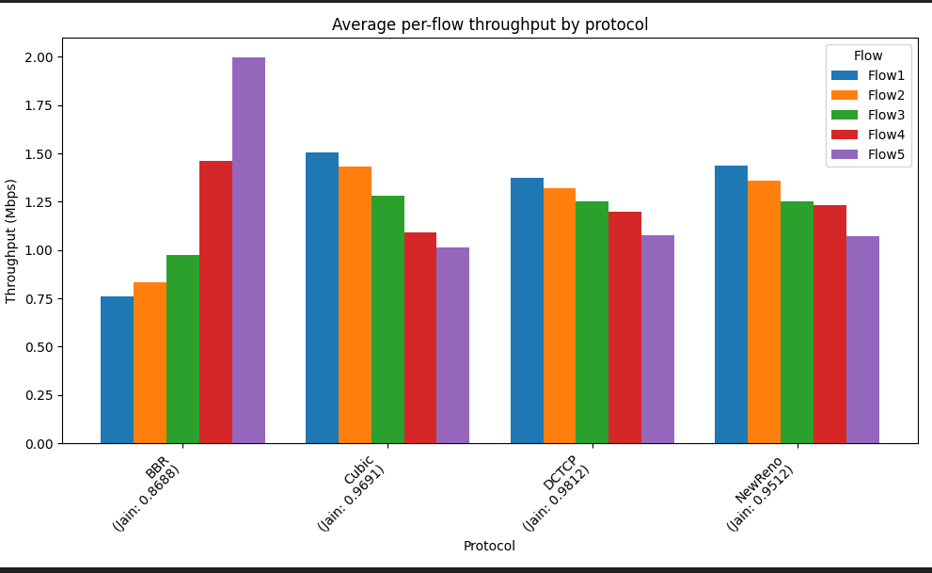
Setup:

Slide 26
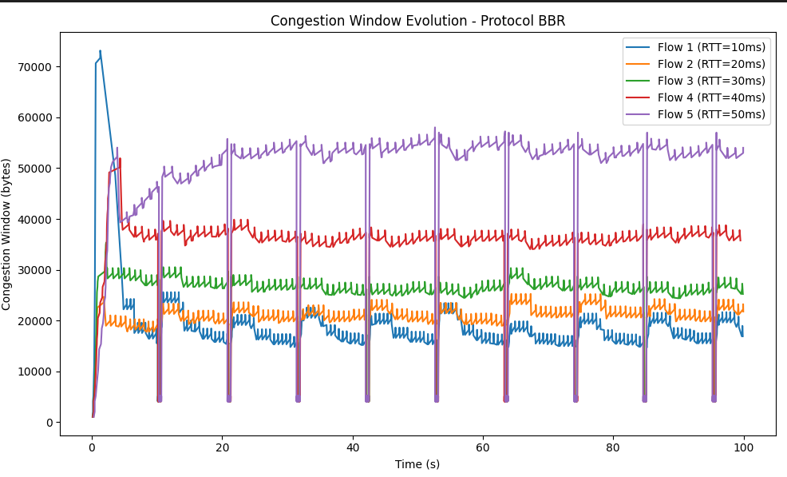
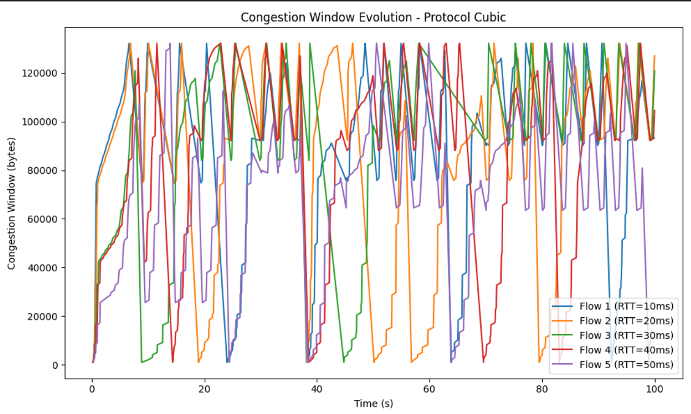
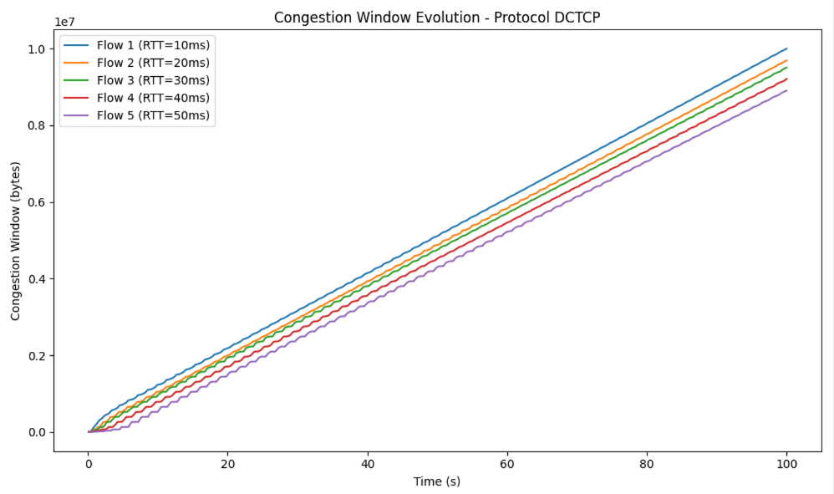
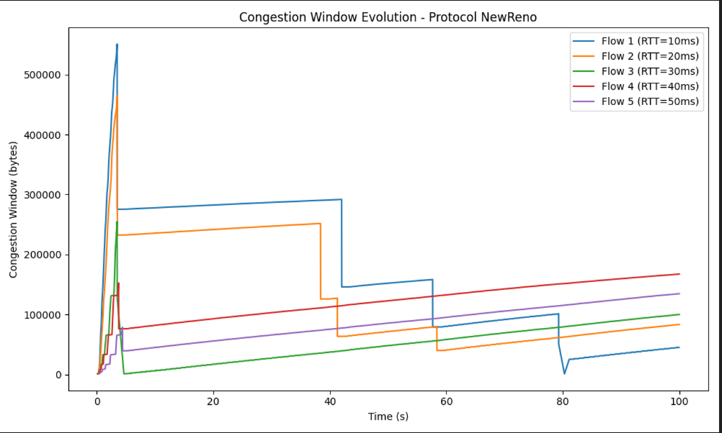

Slide 27
Preliminary results
In the unequal-RTT setup, the cwnd appears to be functioning correctly for most protocols (NewReno, CUBIC, and BBR). However, for DCTCP the cwnd evolution is not behaving as expected, which suggests a configuration or implementation issue. This irregularity indicates that while the other protocols are operating normally, DCTCP requires further debugging to ensure fair and correct operation in the simulation.

Slide 28
Test 3 – Start-Time Bias (Early vs Late Flows)
Why: To test if early-starting flows gain an unfair advantage over flows that start later.
Setup: Flow 1 starts at time 0, Flow 2 starts after a delay (e.g., 15 seconds) , Same protocol, RTT, and size
Metrics: Per-flow throughput, Jain’s Index, Proportional Fairness
Expectations: - Some protocols may allow early flows to dominate bottlenecks - BBR and DCTCP might adapt better over time - Late starters may recover slowly under Reno/CUBIC

Slide 29
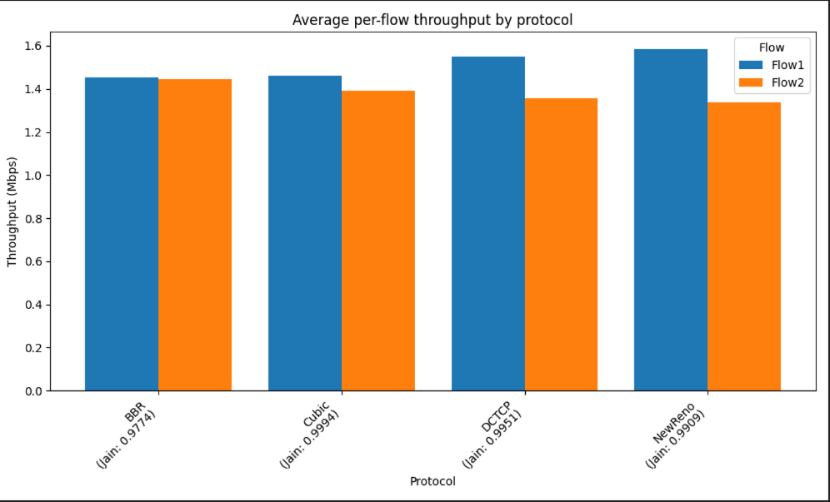
Set up : flow 1=10ms, flow2=10ms, Flow 1 starts at 0s, Flow 2 starts at 15s ,bandwith= 4ms

Slide 30
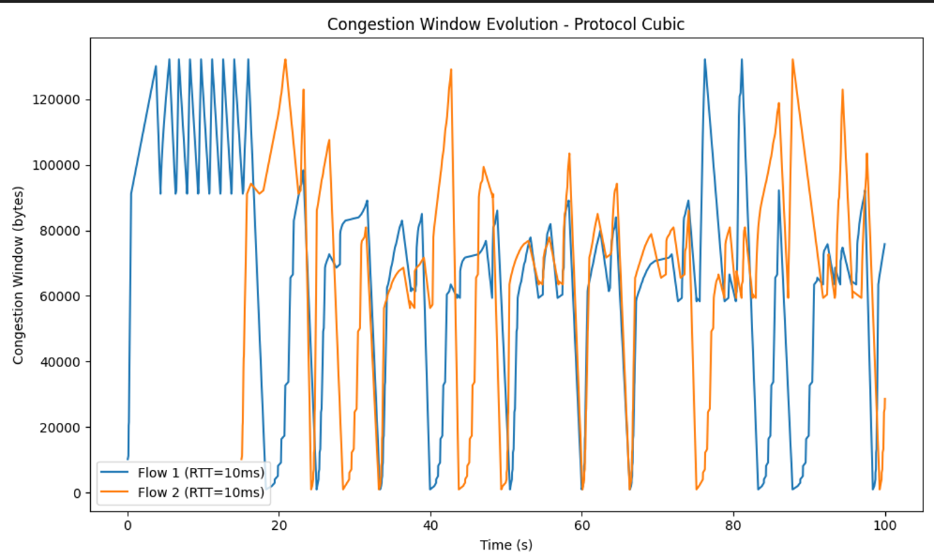
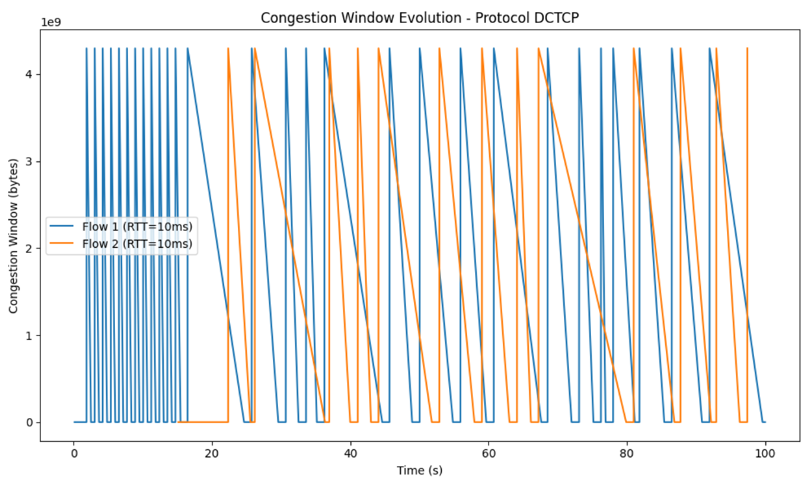
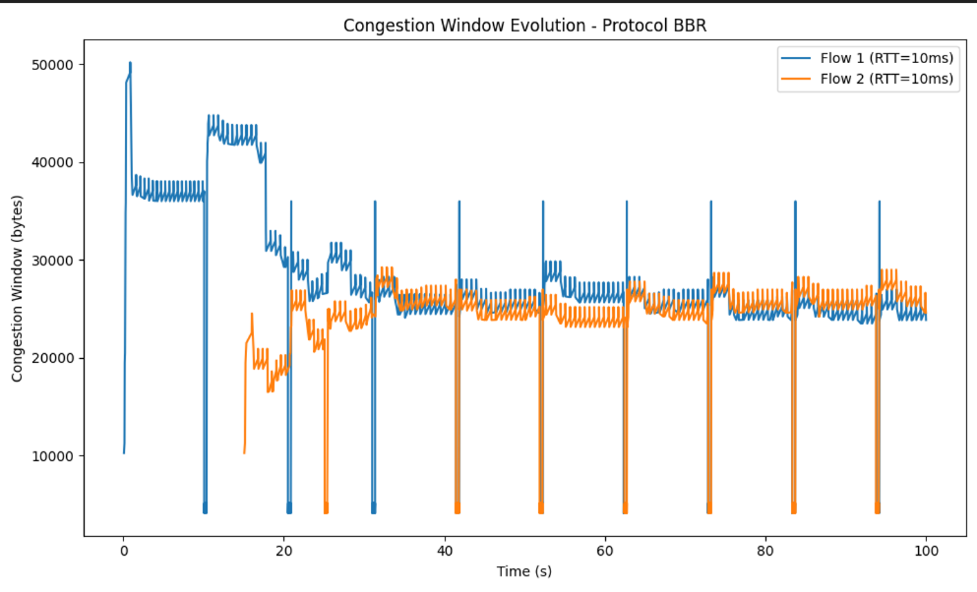
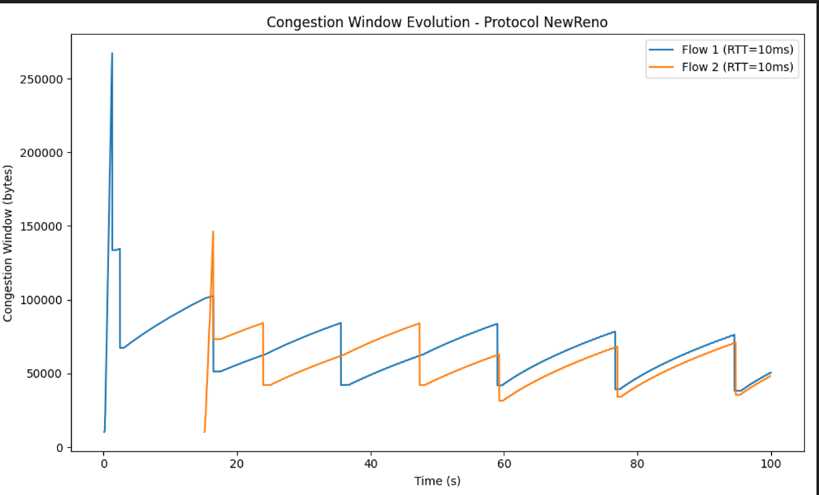

Slide 31
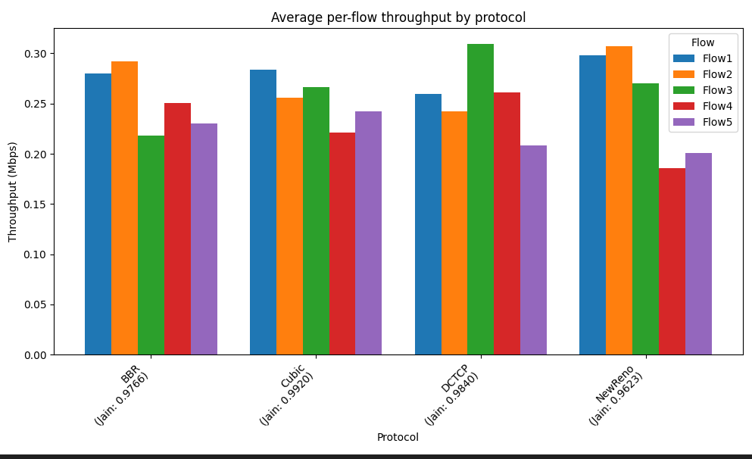
Set up : flow 1=10ms, flow2=10ms, Flow 1 starts at 0s, Flow i starts at 5*(i-1) ,bandwith= 4ms

Slide 32
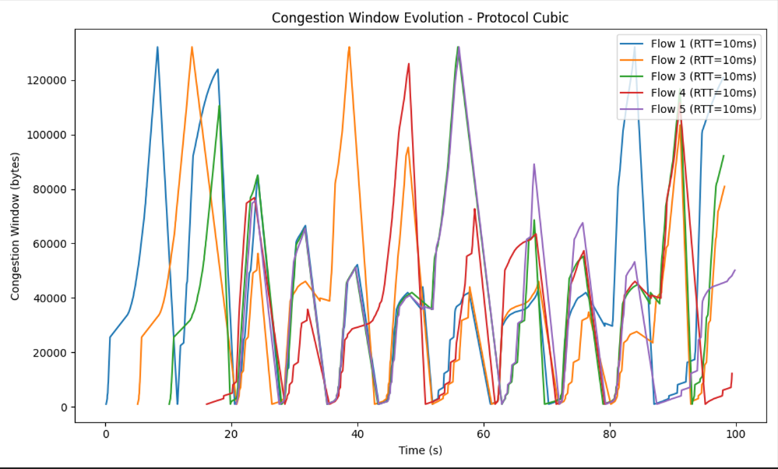
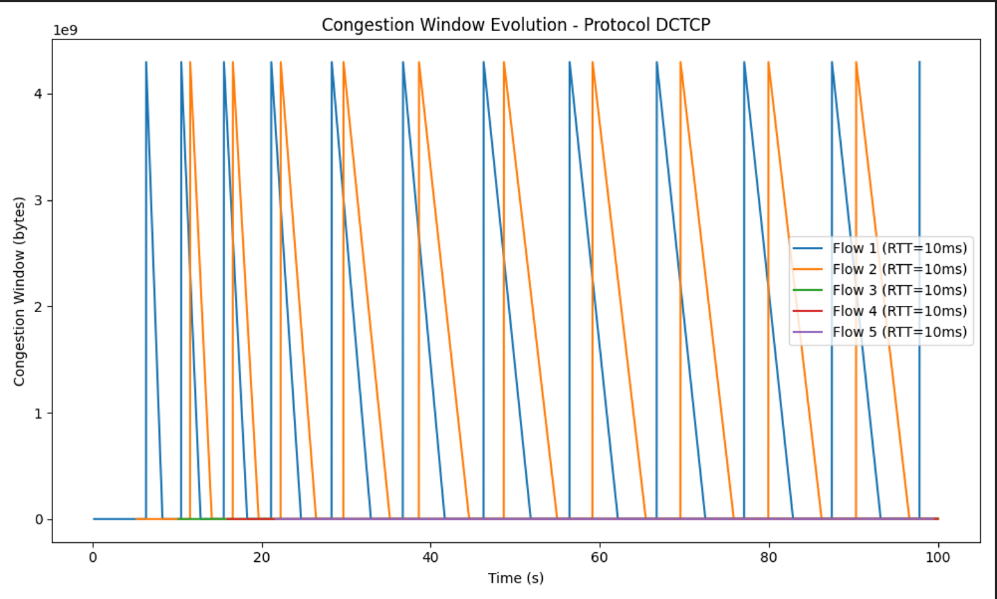
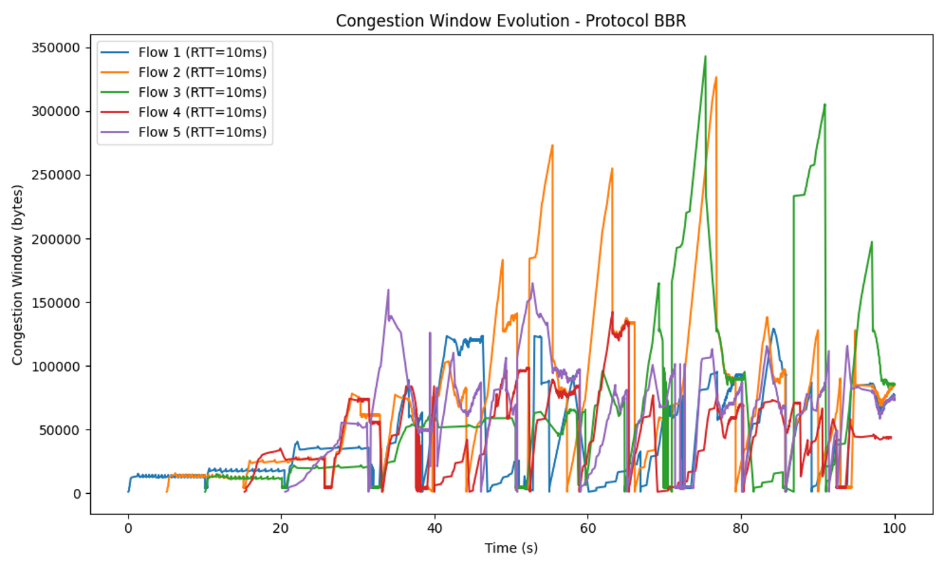
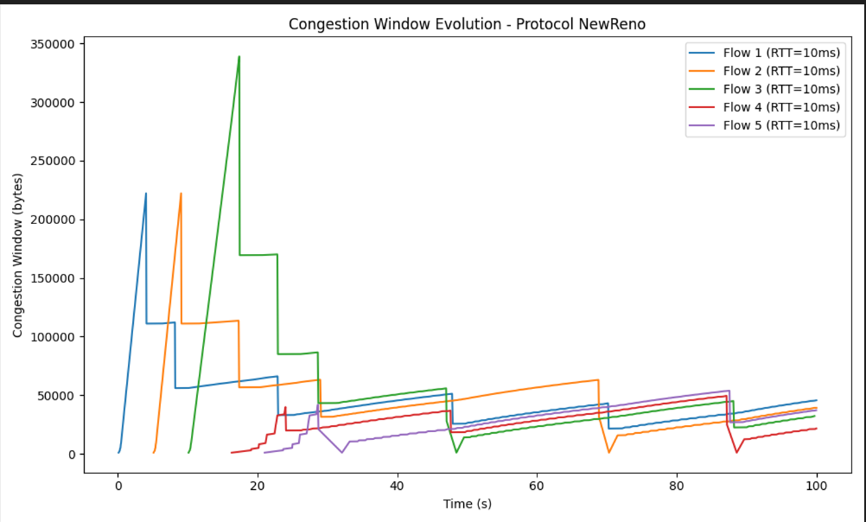

Slide 33
Test 4 - different Protocols
Why: To observe how different TCP protocols handle fairness when flows experience different round-trip times.
Set up: three flows using the different protocols, same RTT
Metrics: Per-flow throughput, Jain’s Index

Slide 34
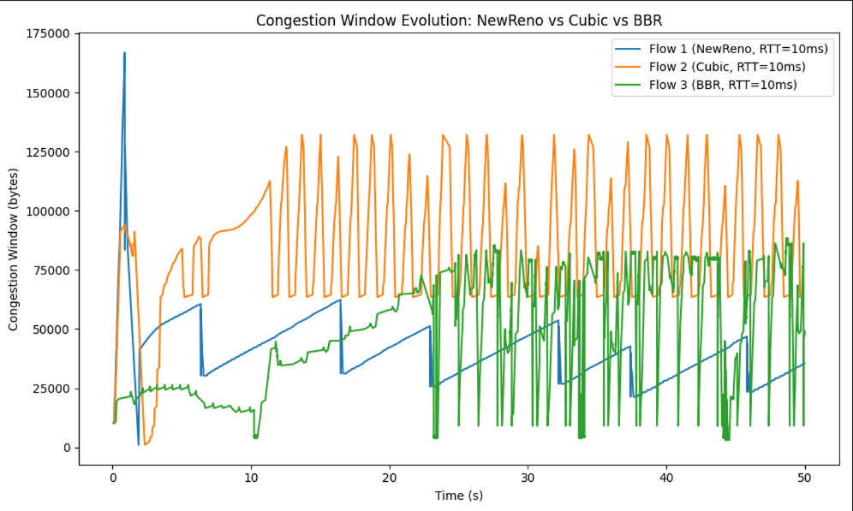

Slide 35
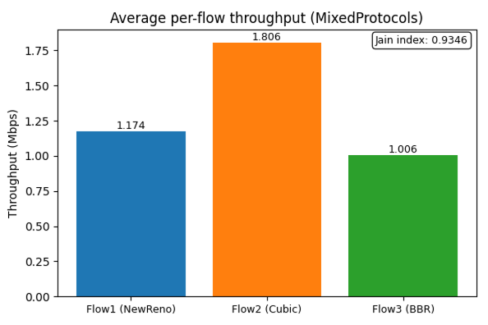

Slide 36
Conclusion
NewReno – Fair under symmetric RTT conditions. – Shows RTT and start-time bias; fairness recovery is conservative and slow. – Behavior consistent in mixed-protocol scenarios, but not the strongest performer.
CUBIC – Performs well in both equal and unequal RTT tests. – Balanced convergence when flows start at different times. – Provides stable throughput but still shows some RTT bias.
BBR – Strong throughput in most scenarios, but favors long RTT flows in unequal RTT setups. – Converges quickly when flows have different start times. – Can cause unfairness compared to other protocols.
DCTCP – Did not function properly in our tests; cwnd behavior was inconsistent. – Results indicate a configuration or implementation issue. – Requires further debugging to assess fairness correctly.

Slide 37
What we learned?
We learned in this project how to use the ns 3.43 environment to run multiple simulations using different variables, and we learned how each protocol behaves and react to different changes in these variables, in addition to that we learned how to build graphs and analyze results we received from the simulations

